Slide 1

RFID Account Validation
Overall concept:
Use RIFD tags to help validate the status of Waste Management’s customer accounts at time of pickup.

Slide 2
How it works
Collection vehicles would be equipped with RFID Readers and a mobile device that directs the driver to collect or continue.

Slide 3
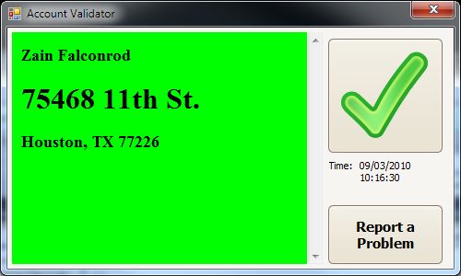
Collect

Slide 4
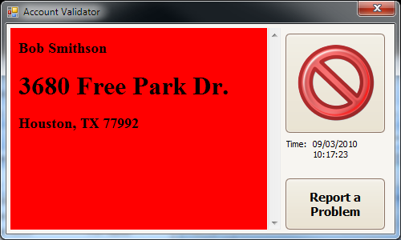
Continue

Slide 5
What’s required?
RFID Tags associated with the customer’s accounting record and attached to the customer’s waste receptacle.
RFID Readers and mobile device attached to the collection vehicle.
Data from Waste Management containing the current status of the customer’s account.

Slide 6
Additional Benefits
Mobile device data can be updated as often as needed to ensure accurate waste removal.
Information about the actual route taken can be stored based on the tags along the route.
Time between pickups can be recorded to ensure efficient route planning and execution.

